Slide 1
Assignment Report

Slide 2
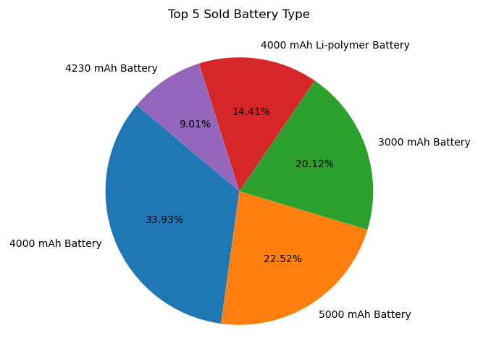
Univariate Analysis of Battery

Slide 3
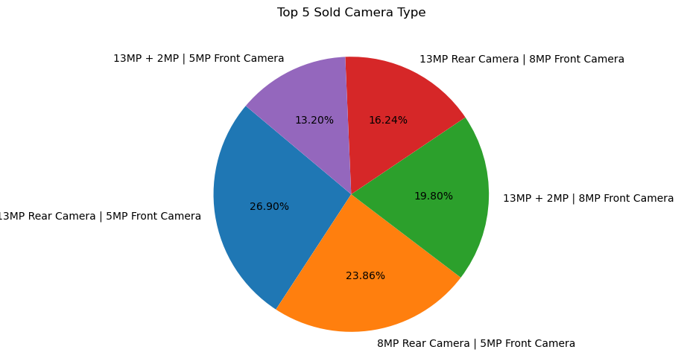
Univariate Analysis of Camera

Slide 4
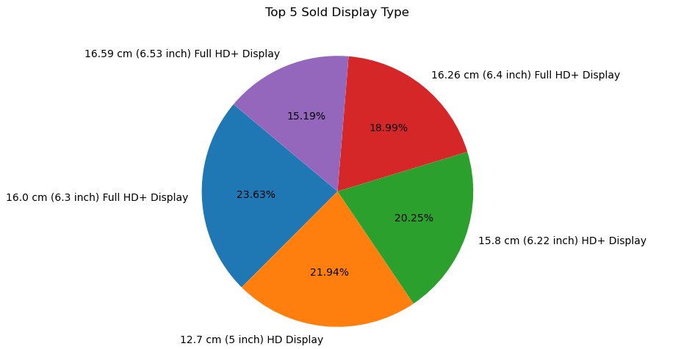
Univariate Analysis of Display

Slide 5
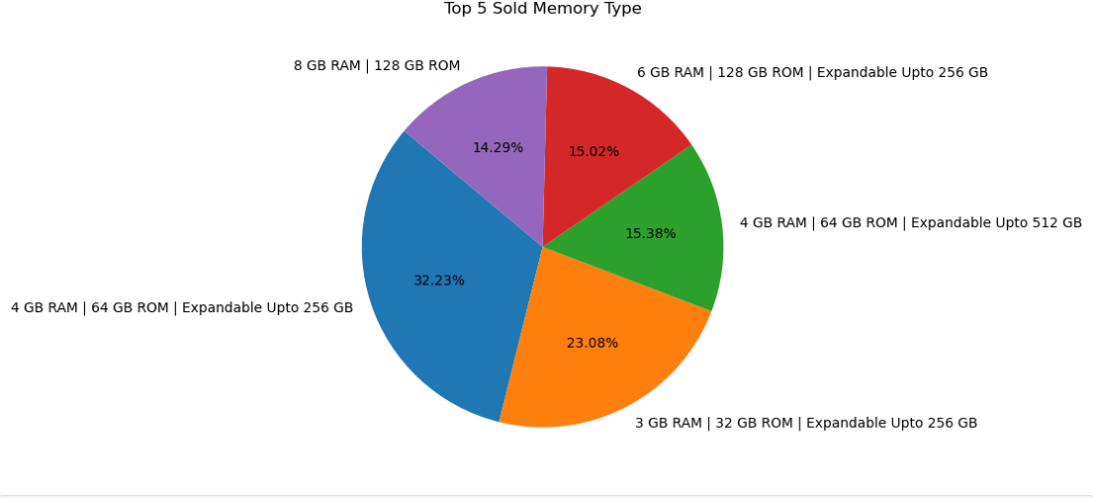
Univariate Analysis of Memory

Slide 6
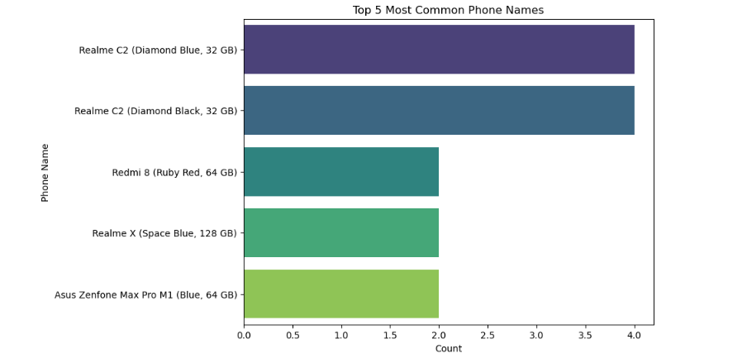
Univariate Analysis of Phones

Slide 7
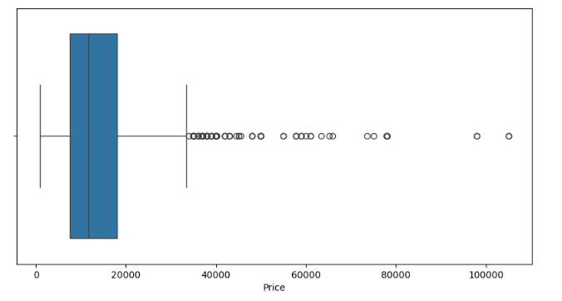
Univariate Analysis of price

Slide 8
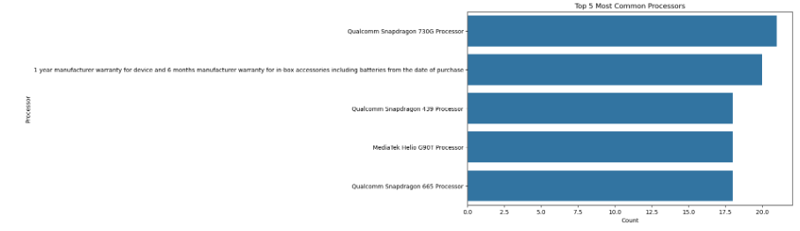
Univariate Analysis of Processor

Slide 9
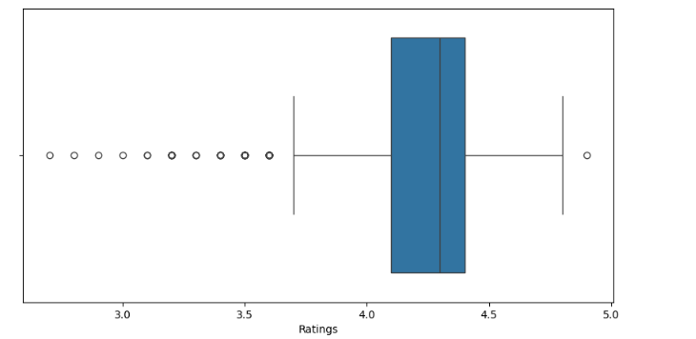
Univariate Analysis of Ratings

Slide 10
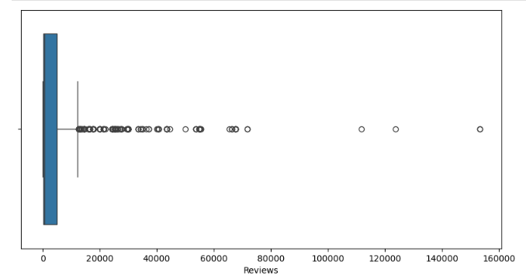
Univariate Analysis of Reviews

Slide 11
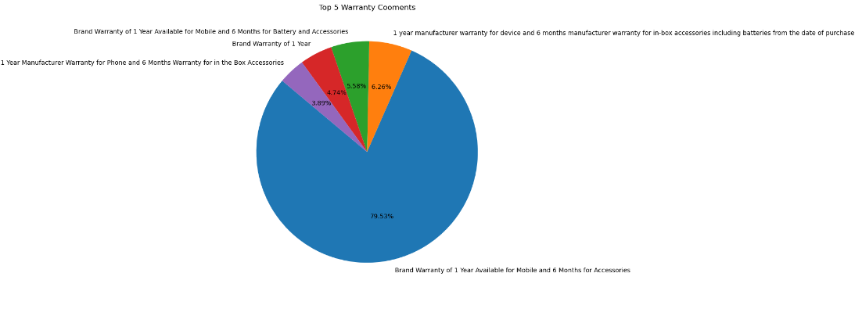
Analysis of Warranty

Slide 12
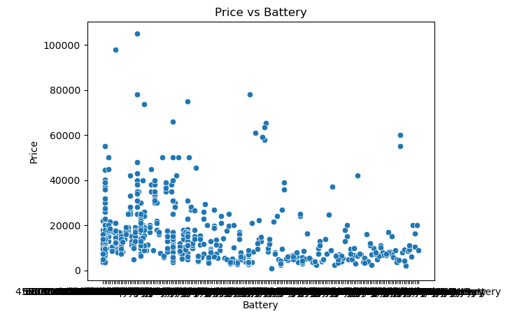
Bivariate Analysis of Price vs Battery

Slide 13
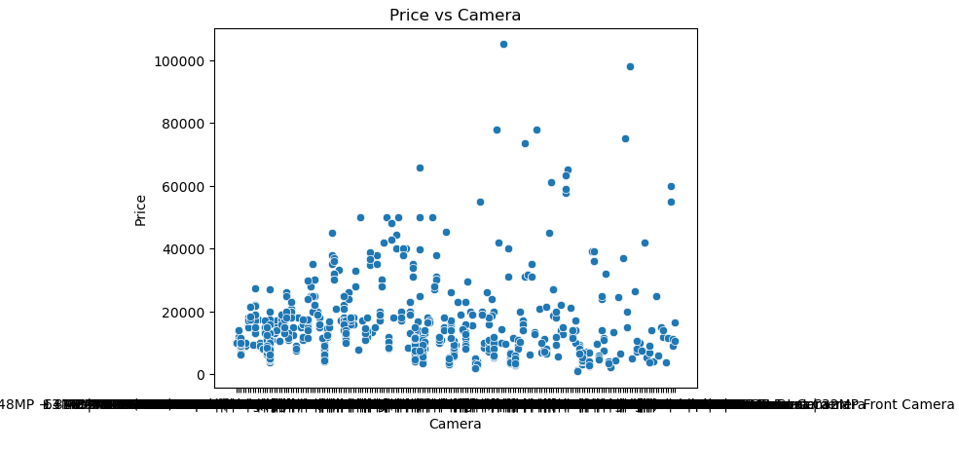
Bivariate Analysis of Price and Camera

Slide 14
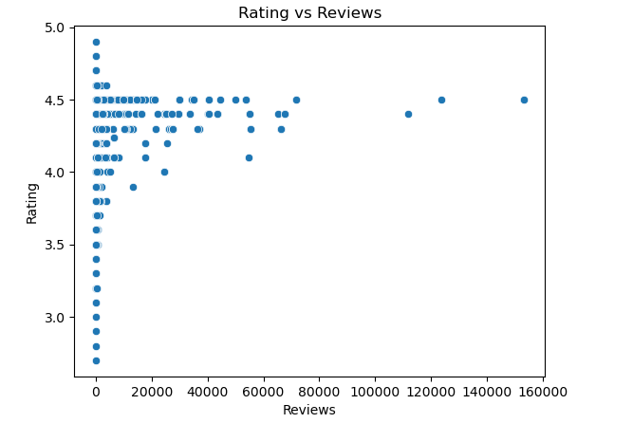
Ratings vs Reviews

